Slide 1
Blood Flukes
Family: Schistosomatidae:
Schistosoma and other spp.
Elongate bodies without pharynx, in birds (many genera); mammals (3 genera), eggs non-operculate, live in blood vessels, especially mesenteric blood vessels.
Schistosoma spp. (in mammals; 4 groups)
A. Schistosoma haematobium group
- 7 species
- most use Bulinus snails as intermediate host.
- indigenous to Africa and adjacent regions
- most with posterior spine on egg

Slide 2
- S. haematobium, S. intercalatum, S. mattheei in primates. Available evidence suggests that S. haematobium can cause urinary bladder carcinoma
- S. mattheei, S. bovis, S. curassoni, S. margrebowiei, S. leiperi in artiodactyla
B. Schistosoma mansoni group
- 4 species
- most used Biophalaria snails as intermediate host.
- indigenous to Africa; introduced to the Caribbean and South America
- most with large, sublateral spine of egg

Slide 3
Species:
1. S. mansoni in primates and rodents
2. S. rodhaini in carnivores and rodents
3. S. edwardiense, S. hippopotami in artiodactyla
C. Schistosoma indicum group
- 4 species
- most species use Indoplanorbis snails as intermediate hosts.
- indigenous to Asian countries
- Most species have egg with terminal spine
1. S. indicum, S. spindale, S. nasale in artiodactyla
2. S. incognitum in rodents, carnivores, and artiodactyla

Slide 4
D. Schistosoma japonicum group
- 4 species
- variety of snails as intermediate hosts.
- indigenous to Asian countries
- most eggs spherical or subspherical, with small spine
- S. japonicum in primates, rodents, and carnivores. Evidence suggests that this parasite may cause hepatic carcinoma.
1. S. mekongi in primates and carnivores
2. S. sinensium, S. malayensis in rodents

Slide 5
life-cycle of Schistosoma spp.
Adults in veins in visceral region; females inch down into venioles to release eggs, eggs trapped in capillaries; granuloma; out with feces or urine or remain trapped, embryonate en route, then hatch to miracidia, miricidium penetrates snail and two sporocyst generations released after that furcocercouscercariae released and penetrate skin of definitive host resulting to schistosomule migrates; blood vessels; heart; liver, this will be matures in about three weeks and migrate down veins to sites of infection; en route males and females pair.

Slide 6
Pathology and Immunology
- adults evade immune system by coating themselves with host proteins
- adults cause little damage
- most pathology associated with eggs; many carried to exotic sites
- delayed type hypersensitivity around egg granulomas; leaking antigens; eosinophilia; neutrophilia
- blood vessel occlusion; fibrosis; bloody diarrhea; bloody urine; edema; ascites; cirrhosis
- a few reports have suggested that the pharaoh Akhenaton may have had Schistosoma haematobium

Slide 7
- some historical reports have suggested that Napoleon Bonaparte, who had chronic dysuria, may have acquired Schistosoma haematobium during his Egyptian campaign of 1798.
Other Genera and Species
- Schistosoma tiumdouthitti
1- rodents and lagomorphs in far North America
2- hepatic portal system
- Heterobilharzia americanum
1. medium sized mammals; carnivores; in North America
2. in raccoons
- Gigantobilharzia, Bilharziella, Trichobilharzia, Microbilharzia, etc.
Found in birds

Slide 8
- Ornethobilharzia turcestanicum
Found in the blood vessels of cattle.
So, Generally:
Schistosome: A parasitic trematode worm contracted from infested water that is capable of causing liver, gastrointestinal tract and bladder disease.
Three main species of these trematode worms (flukes) ----- Schistosoma mansoni, S. haematobium, and S. japonicum, that produce disease in humans.
Schistosomiasis or bilharzia after the German physician Theodor Bilharz (1825-1862). Nickname “Bill Harris” by British soldiers serving in Europe during WWI.

Slide 9
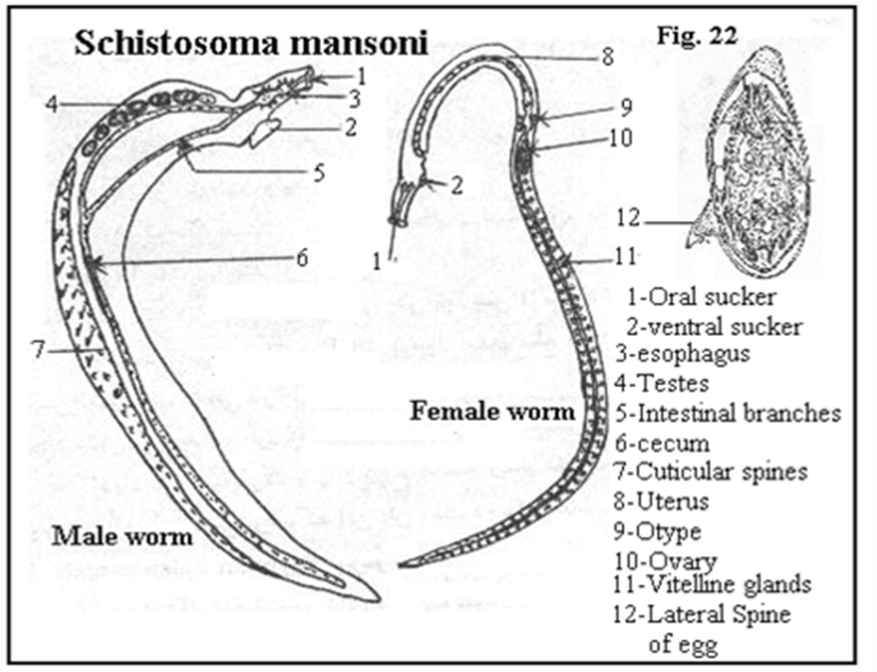


Slide 10
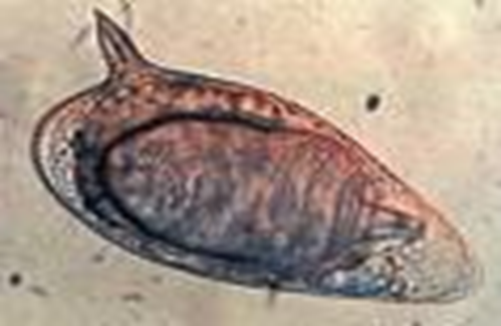
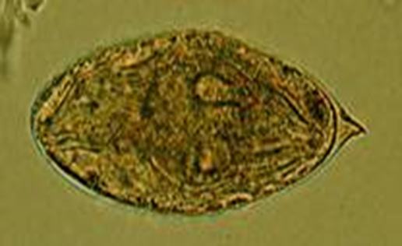


Ova of S. mansoni with lateral spin Ova of S. haematobium with terminal spin

Slide 11
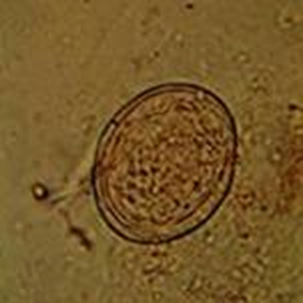

Ova of S. japonicum with minute spin or knob

Slide 12
Definitive Host/ Intermediate Host
Definitive host: Human
Intermediate host: Snail
Biomphalaria (S. mansoni)
Bulinus (S. haematobium)
Oncomelania (S.japonicum)
Reservoirs: monkeys, rodents, cats, dogs, cattle, horses, swine, wild mammals.

Slide 13
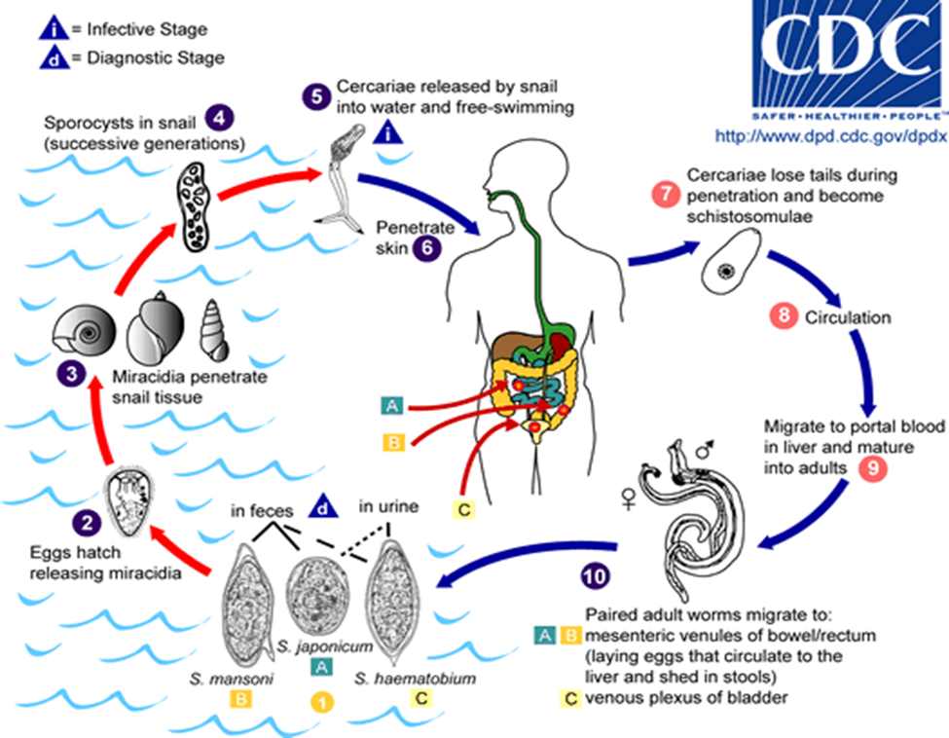


Slide 14
many cause swimmer's itch, where cercaria penetrate skin, die, and cause inflammation in abnormal hosts
Pathogenesis
1- S. mansoni
most pathogenic
site of infection: veins of large intestine
2- S. haematobium
bloody urine
site of infection: veins of bladder
3- S. japonicum
high morbidity
site of infection: veins of small intestine

Slide 15
Clinical Symptoms
Migratory phase
Symptomless
Acute phase (Katayama fever)
Chills, fever, fatigue, headache, muscle aches, cough, abdominal pain, diarrhea, and eosinophilia.
Chronic phase
Bloody diarrhea, enlargement of liver and spleen, ascites, bloody urine, bladder cancer, kidney problems, CNS lesions.

Slide 16
Control & Prevention
Education of the public
Sanatation of drinking water
Diagnosis and treatment
Management of the environment
Control of the intermediate hosts (freshwater snails).
Diagnosis
Microscopic identification of eggs in stool or urine (most practical)
Tissue biopsy- rectal or bladder biopsy may demonstrate eggs when stool or urine examinations are negative.
Antibody detection
Morphologic comparison with other intestinal parasites

Slide 17
Treatment
praziquantel -drug of choice, effective in the treatment of all forms of Schistosomiasis, with virtually no side effects
Oxamniquine -used exclusively to treat intestinal schistosomiasis in Africa and South America
Metrifonate - effective for the treatment of urinary schistosomiasis
No vaccinations currently available.

Slide 18
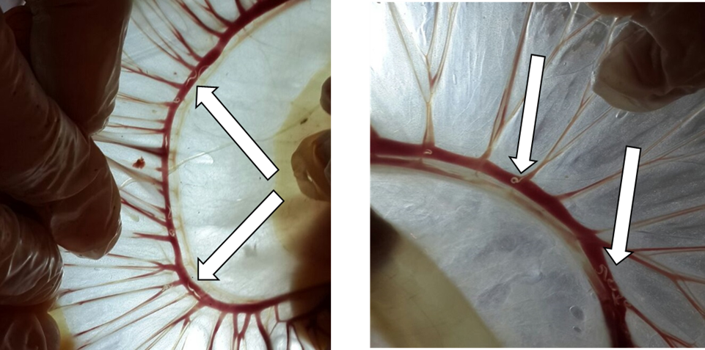


Slide 19
THANK YOU

